Slide 1

Walchand College of Engineering, Sangli
Department of Information Technology
A
Presentation on
Design and Implementation of Rao’s Algorithm on Spark Framework
Presented By Guided by:
1.Shraddha Varma (2017bteit00203) Dr. A. J. Umbarkar
2.Shreya Bodhane (2017bteit00204)
3.Sumit Lohar (2017bteit00207)
<number>

Slide 2
Problem Statement
Design & Implementation of Rao’s Algorithm on Spark for Solving Optimization Problem.
<number>
Notes:
<number>

Slide 3
Objectives
To Design Spark based model of Rao’s Algorithm.
To Implement Rao’s Algorithm in sequential and Distributed Manner on Spark.
Apply Rao’s Algorithm to solve Optimization Problem.
<number>
Notes:
<number>

Slide 4
Introduction
Spark based Model
Rao’s Algorithm- Type of Evolutionary Algorithm.
Population based iterative algorithm
Controlling parameters
Population size
Design variables (Dimensions)
<number>
Notes:
<number>

Slide 5
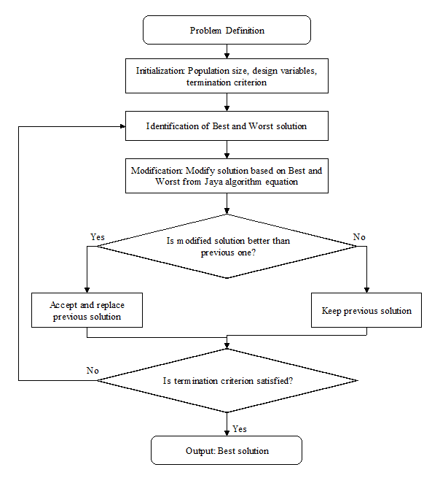
<number>
Notes:
<number>

Slide 6

Rao’s Algorithm Example
Algorithm Equation: X’ _{j, k, i} = X _{j, k, i} + r_{1, j, i} (X _{j, best, i} – X _{j, worst,i}) …………..............(1)
Objective Function: Sphere function
Subject to: -100 ≤ Xi ≤ 100 ………………………….......................................(2)
Algorithm Working:
Step: 1 Initialize population and Calculate f(x) using eq. 2 Step: 2 Apply eq. (1) and find new X and f(x) values
R1=0.10 R2=0.50
Table: 1
X’_{1, 1, 1} = X_{1, 1, 1} + r_{1, 1, 1} (X_{1, 4, 1} – X_{1 ,2, 1} )
= -5 +0.10 (-8-14)=-7.2,
X’_{2, 1, 1} = X_{2,1, 1} + r_{1, 1, 1} (X_{2, 4, 1} – X_{2 ,2, 1} )
= 18+ 0.50 (7-33)= 5.
Step: 3 Update values of X and f(x)
(Compare f(x) of Table:1 and Table:2)
Table: 3
Dimension Population | X1 | X2 | f(x) | Status
1 | -5 | 18 | 349
2 | 14 | 33 | 1285 | Worst
3 | 30 | -6 | 936
4 | -8 | 7 | 113 | Best
5 | -12 | -18 | 468
Dimension Population | X1 | X2 | f(x)
1 | -7.2 | 5 | 76.84
2 | 11.8 | 20 | 539.24
3 | 27.8 | -19 | 1133.84
4 | -10.2 | -6 | 140.04
5 | -14.2 | -31 | 1162.64
Dimension Population | X1 | X2 | f(x) | Status
1 | -7.2 | 5 | 76.84 | Best
2 | 11.8 | 20 | 539.24
3 | 30 | -6 | 936 | Worst
4 | -8 | 7 | 113
5 | -12 | -18 | 468
<number>

Slide 7
Parameters:
Design parameters:
Performance parameters:
Sr. No. | Parameters | Size
1 | Population Size | 10000
2 | Number of Dimensions | 2, 5, 10, 30, 50, 100
3 | Number of Iterations | 100000
4 | Termination Condition | Algorithm stops when number of iterations get completed
Parameters
Best solution | Speedup
Mean solution | Success rate
Worst solution | Number of iterations
Standard deviation | Ideal value
Computation Time | Fitness Value
<number>
Notes:
<number>

Slide 8
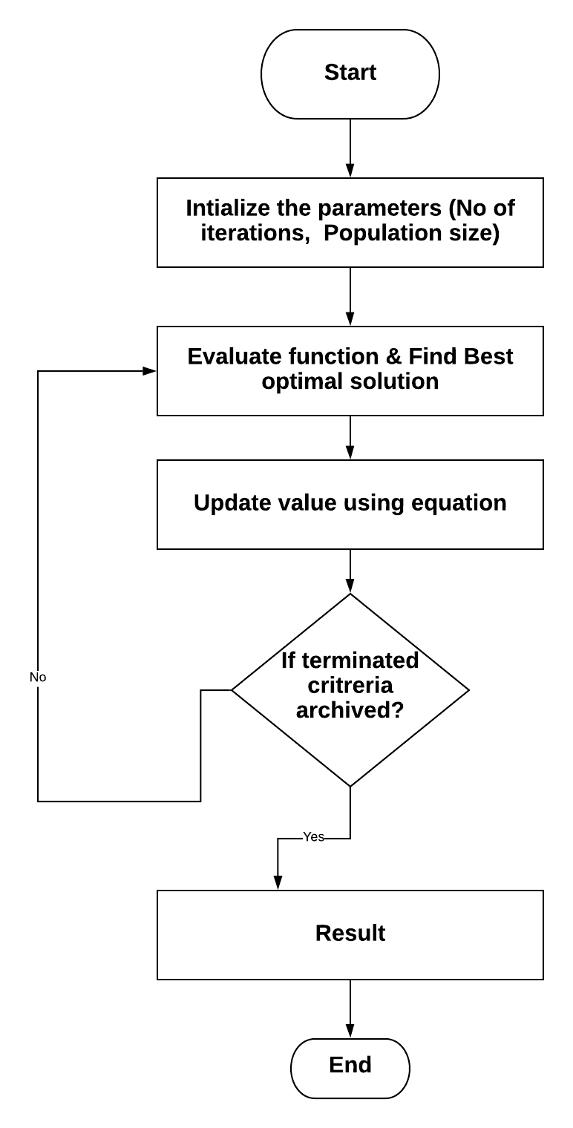
Methodology
<number>
Notes:
<number>

Slide 9
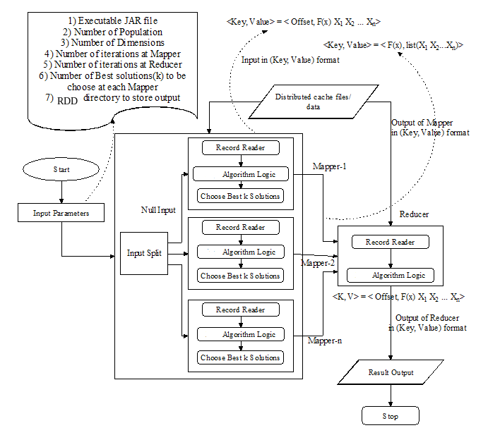
<number>
Notes:
<number>

Slide 10
References
R. V Rao,“Rao algorithm:three metaphor simple algorithm for solving optimization problem” of IJIEC vol 11,2020
J. Dean, and S. Ghemawat, "MapReduce: simplified data processing on large clusters." Communications of the ACM, vol. 51.1, pp. 107-113, 2008.
Y. Zhang, X. Yang, C. Cattani, and R. V. Rao, "Tea category identification using a novel fractional fourier entropy and Jaya algorithm." Entropy vol. 18.3 pp. 77, 2016.
R. V Rao, K. C. More, and J. Taler, "Dimensional optimization of a micro-channel heat sink using Jaya algorithm." Applied Thermal Engineering, vol. 103 pp. 572-582, 2016.
S. V. Ashok, and D. P. Schrage, "Optimization techniques for gear train design," American Helicopter Society International Annual Forum, Phoenix, Arizona, 2013.
Deb, and Kalyanmoy, "Optimization for engineering design algorithms and examples," PHI Learning Pvt. Ltd., 2012.
<number>
Notes:
<number>

